Slide 1

Capstone Project
SEOL BIKE SHARING DEMAND PREDICTION
By
Mohammed Haseebuddin
&
Pavan Potnuru

Slide 2
POINTS TO DISCUSS
Problem Statement
Business Understanding
Data Summary
Exploratory Data Analysis
Feature Engineering
Model Fitting
Evaluating Models
Conclusion

Slide 3

PROBLEM DESCRIPTION:
Currently Rental bikes are introduced in many urban cities for the enhancement of mobility comfort. It is important to make the rental bike available and accessible to the public at the right time as it lessens the waiting time. Eventually, providing the city with a stable supply of rental bikes becomes a major concern. The crucial part is the prediction of bike count required at each hour for the stable supply of rental bikes.

Slide 4

BUSINESS UNDERSTANDING
Bike rentals have become a popular service in recent years, and it seems people are using it more often. With relatively cheaper rates and ease of pick up and drop at own convenience is what making this business thrive.
Mostly used by people having no personal vehicles and also to avoid congested public transport that’s why they prefer rental bikes.
Therefore, the business to strive and profit more, it must be always ready and supply no. of bikes at different locations, to fulfill the demand.
Our project goal is a pre planned set of bike count values that can be a handy.

Slide 5
DATA SUMMARY
Date : Year-Month-Day
Rented Bike Count - Count of bikes rented at each hour
Hour - Hour of the day
Temperature(C) - Temperature in Celsius
Humidity (%) - % Water vapor present in air
Wind Speed - m/s
Visibility - 10m
Dew point temperature -Celsius
Solar radiation -MJ/m2
Rainfall -mm
Snowfall –cm
Seasons -Winter, Spring, Summer, Autumn
Holiday -Holiday/No Holiday
Functional Day - (Non-Functional Hrs.),(Functional Hrs.)

Slide 6
DATA SUMMARY
This Dataset contain 8760 rows and 14 columns.
Three categorical features ‘Seasons’, ‘Holiday’, & ‘Functioning Day’.
One Datetime column ‘Date’.
We have some numerical type variables such as temperature, humidity, wind, visibility, dew point temp, solar radiation, rainfall, snowfall which shows the environmental conditions for that particular hour of the day.
There are No Missing Values present
There are No Duplicate values present
There are No null values.
The dependent variable is 'rented bike count' which we need to make predictions on.
The dataset shows hourly rental data for one year (1 December 2017 to 31 November 2018) (365 days).

Slide 7
FEATURE TYPES
Numerical
Categorical
Target Variable
Temperature(°C)
Humidity(%)
Wind Speed(m/s)
Visibility(10m)
Dew point temperature(°C)
Solar radiation(MJ/m^2)
Rainfall(mm)
Snowfall(mm)
Seasons
Holiday
Functional day
Bike Count

Slide 8

EXPLORATORY DATA ANALYSIS
Exploratory Data Analysis refers to the critical process of performing initial investigations on data to discover patterns, to spot anomalies, to test hypothesis and to check assumptions with the help of summary statistics and graphical representations.

Slide 9
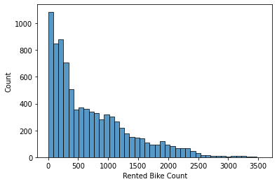
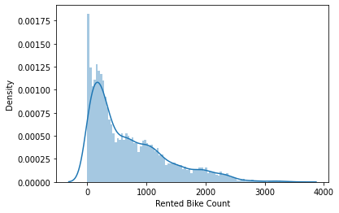
EDA
Rented bike count is our Target variable, distribution of rented bike count is positively skewed

Slide 10
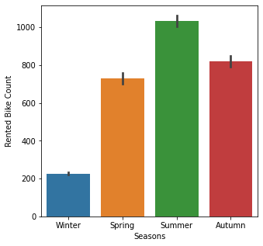
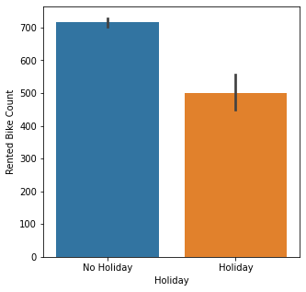
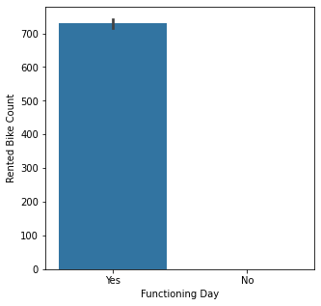
EDA(cont.)
Demand for rented bikes in more is autumn and summer
Demand for bikes is more in functional days
We see more rented bike counts in non holidays

Slide 11
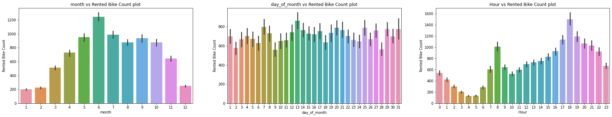
EDA(cont.)
Count of rented bikes increases to higher values from May to September
Count of rented bikes is high in mid of the month, but there is drop in count (might be due to weekend)
Count of rented bikes is high from 8 am to 10 am and again increases from 3 pm to 8 pm

Slide 12
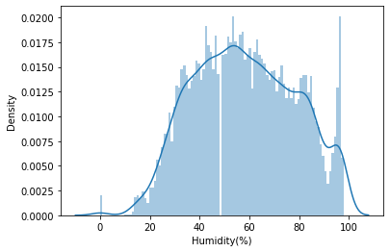
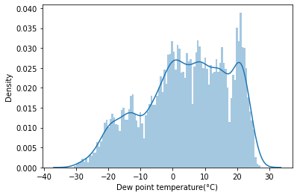
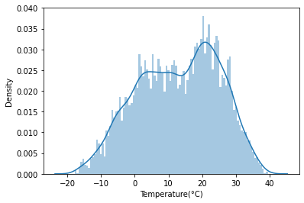
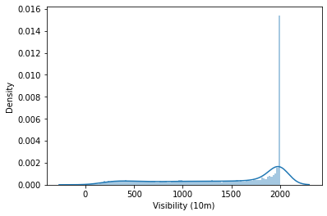
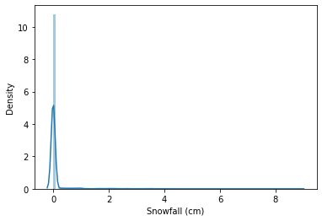
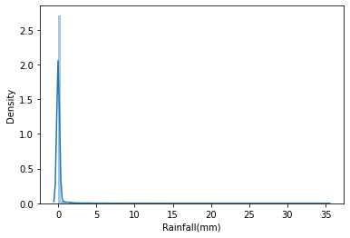
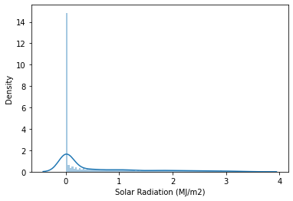
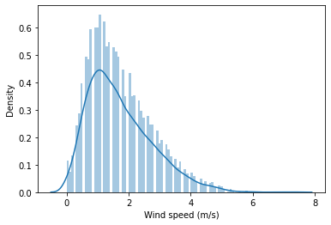
DISTRIBUTION OF NUMERICAL VARIABLES

Slide 13
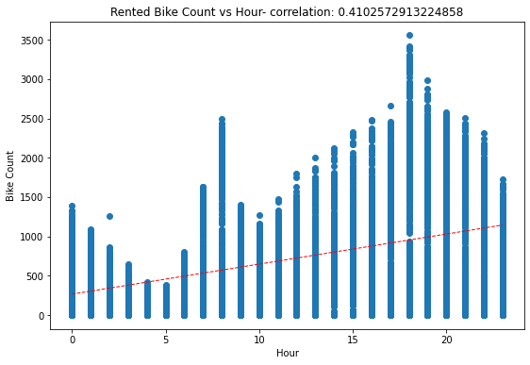
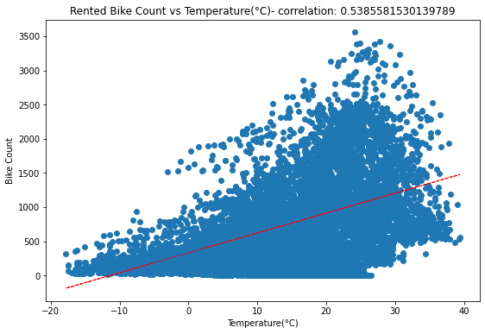
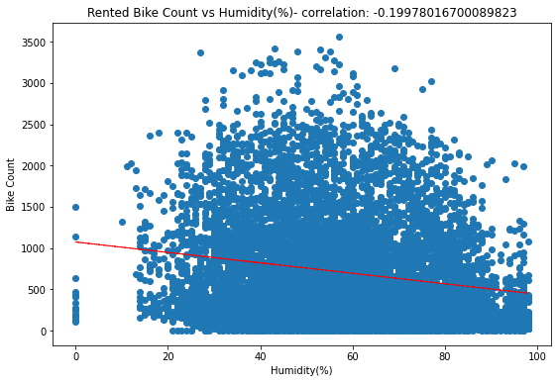
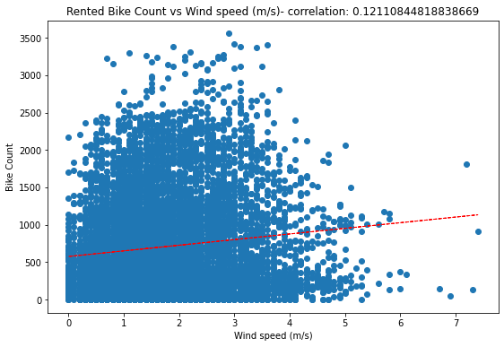
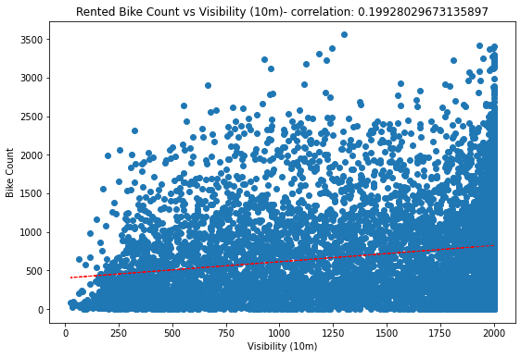
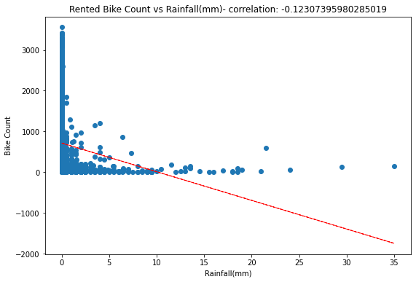
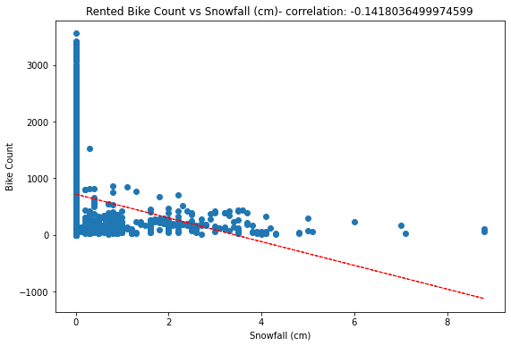
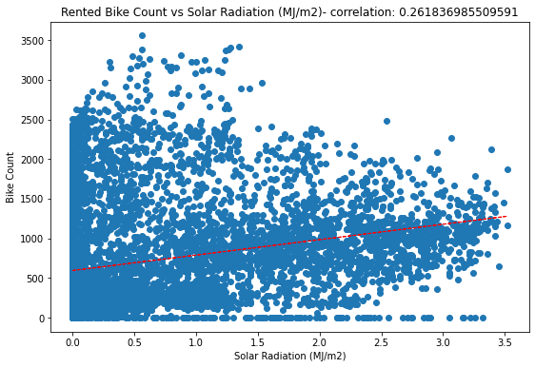
DISTRIBUTION OF NUMERICAL VARIABLES

Slide 14
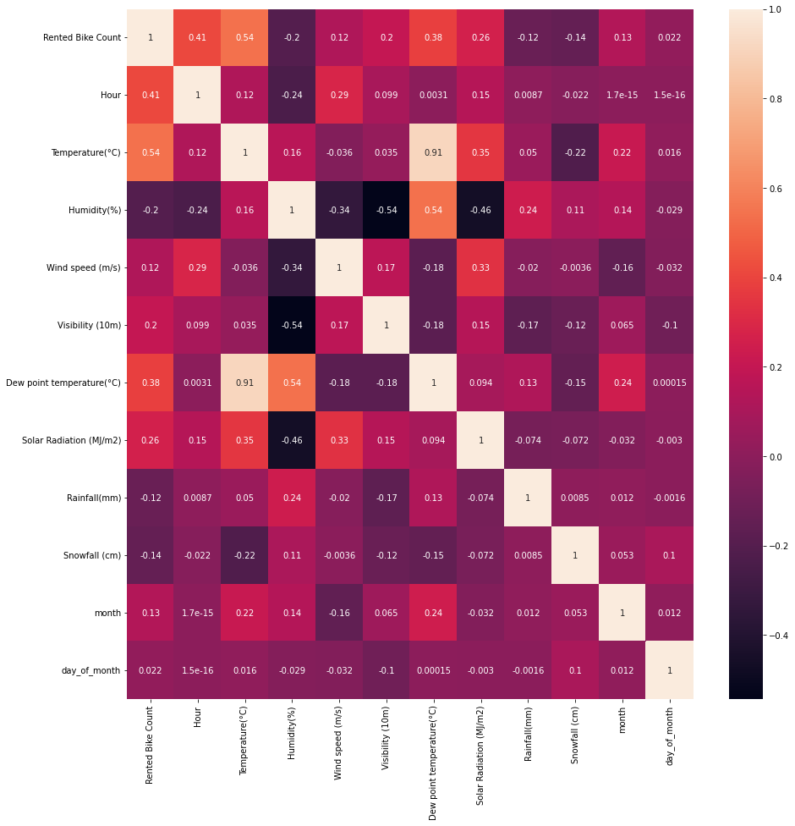
CORRELATION HEATMAP
Very High corelation between ‘Temperature’ and ‘Dew point temperature’
‘Humidity is moderately corelated with ‘solar radiation’ and ‘visibility’

Slide 15

FEATURE ENGINEERING
Feature engineering is the process of selecting, manipulating, and transforming raw data into features that can be used in supervised learning. In order to make machine learning work well on new tasks, it might be necessary to design and train better features.

Slide 16
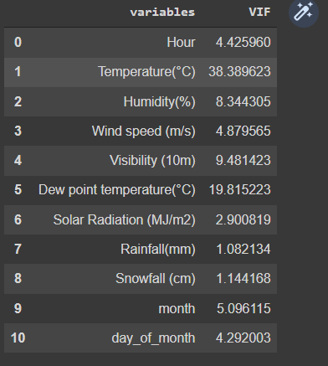
FEATURE ENGINEERING
Variance Inflation Factor:
Variance inflation factor (VIF) is a measure of the amount of multicollinearity in a set of multiple regression variables. Mathematically, the VIF for a regression model variable is equal to the ratio of the overall model variance to the variance of a model that includes only that single independent variable.
Variance inflation factor is high for Temperature (C), Dew point temperature(C), Visibility(10m), and Humidity(%) i.e., more than 5.

Slide 17
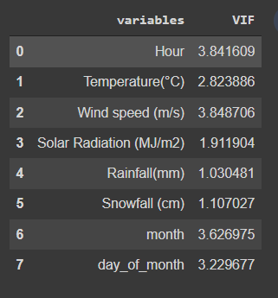
FEATURE ENGINEERING
Variance Inflation Factor:
We have removed the columns (Due point temperature (C), Visibility(10m) and Humidity(%) which have VIF more than 5.
After removing these columns we have all the feature with VIF less than 5

Slide 18
FEATURE ENGINEERING
Feature Engineering is the process of selecting , manipulating, and transforming initial variable into features that can be used in model training
New Feature creation
Day_of_month
Newly created features
Date(day, month, year)
Month_num

Slide 19
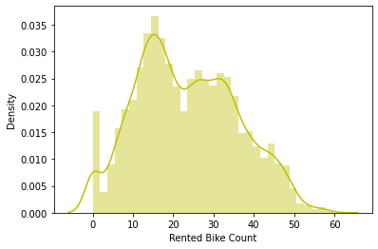
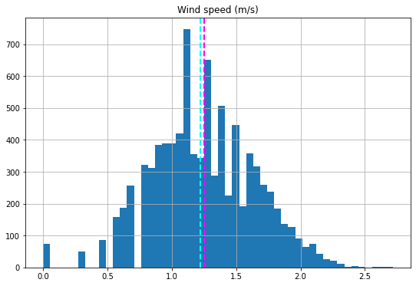
FEATURE TRANSFORMATION
Some of the features are skewed so we can apply sqrt, log10 to reduce skewedness
Original Features
Transformed Features
Sqrt(Rented bike count)
Sqrt(Wind Speed)

Slide 20
FEATURE TRANSFORMATION
We have some categorical features in our data set so we cannot directly feed data into our model. We need to transform the categorical data into numerical type by using one hot encoding
Seasons
Summer
Winter
Autumn
Spring
Summer | Winter | Autumn | Spring
1 | 0 | 0 | 0
0 | 1 | 0 | 0
0 | 0 | 1 | 0
0 | 0 | 0 | 1
One hot encoding

Slide 21
APPLYING ML ALGORITHMS
There are algorithms that we will use:
Linear Regression
LASSO Regression
Ridge Regression
Elastic net Regression
Decision Tree
Random Forest
XGBoost

Slide 22
APPLYING ML ALGORITHMS
Steps we follow:
Preparing Data for model
Training and Hyper parameter tuning
Evaluating the model

Slide 23
TRAINING AND HYPERPARAMETER TUNING
We have trained different ML models and performed hyperparameter tuning using GridSearch CV.
Following are the optimal parameters for respective models
Model | Optimal Parameters
LASSO | alpha = 0.01
Ridge | alpha = 20
Elastic Net | Alpha = 0.0014, l1_ratio = 0.8
Decision Tree | max_depth = 5, max_leaf_nodes = 20, min_samples_split = 3
Random Forest | max_depth = 7, n_estimators = 80
XGBoost | max_depth = 9, n_estimators = 100

Slide 24
EVALUATING MODELS
Model | Train Data – MSE | Test Data – MSE | Train Data – R2-Score | Test Data – R2-Score
Linear Regression | 55.29 | 52.60 | 0.58 | 0.55
LASSO | 55.25 | 52.60 | 0.577 | 0.552
Ridge | 55.25 | 52.60 | 0.576 | 0.552
Elastic Net | 55.27 | 52.599 | 0.577 | 0.522
Decision Tree | 125508 | 113611 | 0.726 | 0.698
Random Forest | 78435 | 64694 | 0.844 | 0.812
XGBoost | 63653 | 42880 | 0.897 | 0.847

Slide 25
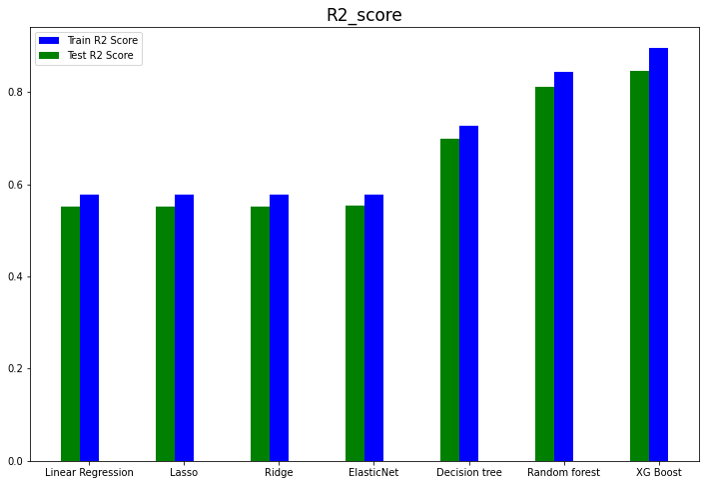
COMPARING DIFFERENT MODELS
We are comparing different Models on the basis of the R2 score, we can see that XGBoot has the highest R2 score. We can conclude that XGBoost worked best in predicting the count of the rented bikes.

